Slide 1
Road Traffic Dataset Aarhus Denmark DS-670
Kapil Bastola
Assignment 6 - Proposal

Slide 2
Content
Novel Contribution
Work By Competitors
Data
Data Visualization
Method

Slide 3
Novel Contribution
Conduct supervised learning algorithms as well as time series analysis to predict future traffic congestion based on historical data
Cross validate the models created using both training and test sets to find the model that performs the best

Slide 4
Work by competitors
The article I am going to make better is:
Short-Term Trafﬁc Flow Forecasting: An Experimental Comparison of Time-Series Analysis and Supervised Learning
Reference
Lippi, M., Bertini, M., & Frasconi, P. (2013). Short-Term Traffic Flow Forecasting: An Experimental Comparison of Time-Series Analysis and Supervised Learning. IEEE Transactions on Intelligent Transportation Systems, 14(2), 871-882. doi:10.1109/tits.2013.2247040

Slide 5
Work by Competitors
The authors first reviewed existing approaches to traffic flow forecasting the common view of probabilistic graphical models, presenting an extensive experimental comparison, which proposes a common baseline for their performance analysis and provides the infrastructure to operate on a publicly available data set.
Then the authors provide two new support vector regression models, which are speciﬁcally devised to beneﬁt from typical trafﬁc ﬂow seasonality and are shown to represent an interesting compromise between prediction accuracy and computational efﬁciency.

Slide 6
Work by Competitors
The set of tested competitors consists of the following algorithms:
1) RW, which is a simple baseline that predicts trafﬁc in the future as equal to current conditions
2) SM, which predicts for a given time of the day the average in the training set;
3) ARIMA model with Kalman ﬁlter
4) SARIMA model with maximum-likelihood ﬁtting
5) SARIMA model with Kalman ﬁlter
6) ANNs
7) Support Vector Regressor (SVR) with RBF kernel
8) SVR with RBF kernel multiplied by a seasonal kernel
9) SVR with linear seasonal kernel

Slide 7
Work by Competitors
The authors found that the Seasonal ARIMA (SARIMA) model coupled with a Kalman ﬁlter is the most accurate model;
However, when forecasting during the most congested periods the seasonal support vector regressor (SVR) was found to be highly competitive method as well

Slide 8
Data
This dataset consists of data from traffic in a city called Aarhus in Denmark. This dataset is collection of traffic data between two points for certain duration of time in CSV format for different durations. A CSV metadata file is also available that provides additional information regarding the different two points.

Slide 9
Data
Among the different duration of data set present in the website, I picked dataset 1 which is from Feb 2014 to June 2014
The downloaded dataset zip file had 449 CSV files in total.
I used zeppelin to bring these files together for further analysis

Slide 10
Data
Upon further analysis it was found that the dataset has 9 columns. These are:
status,
avgMeasuredTime,
avgSpeed,
extID,
medianMeasuredTime,
TIMESTAMP,
vehicleCount,
_id, and
REPORT_ID.

Slide 11
Data
For further data analysis I combined all the files in the directory mentioned above into one table called “roadtraffic” using Spark
I registered the table as an SQL table and ran queries to see what the dataset looks like and obtain data summary.

Slide 12
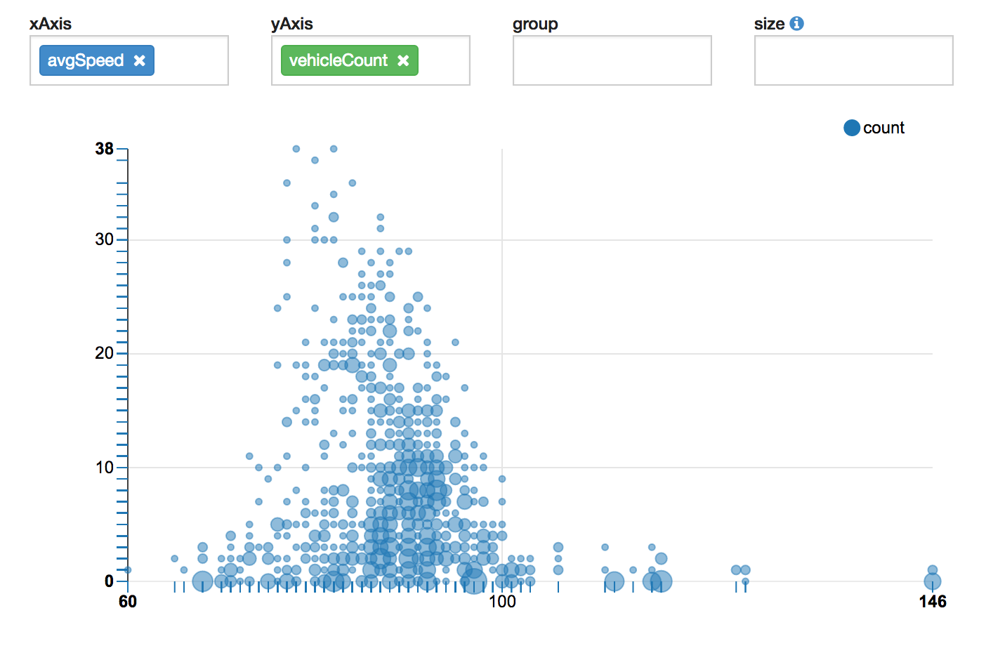
Data Scatter Plot of Average Speed vs. Vehicle Count

Slide 13
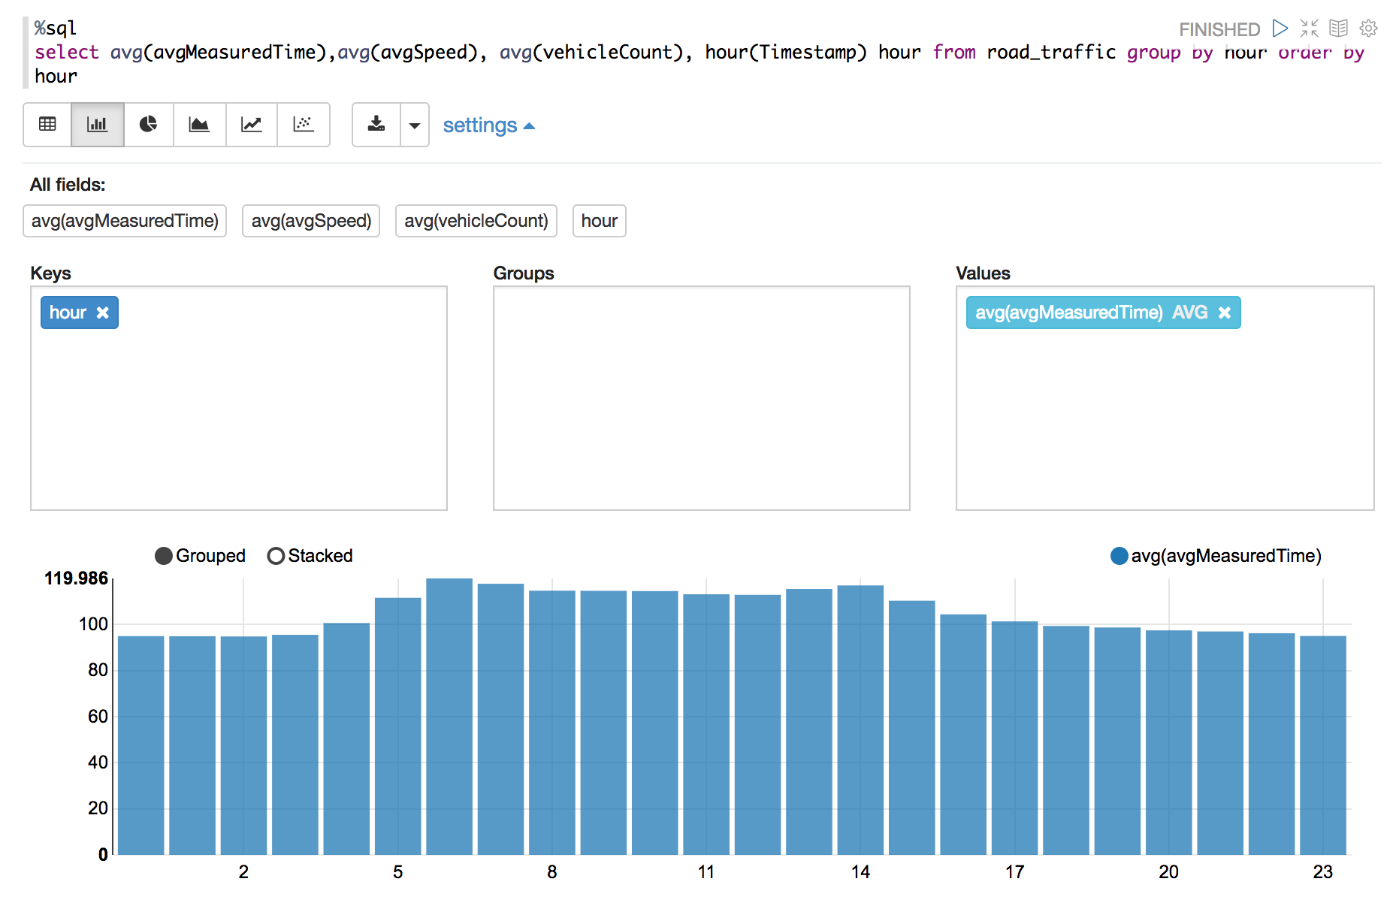
Data Visualization Bar chart of average measured time grouped by hour of day

Slide 14
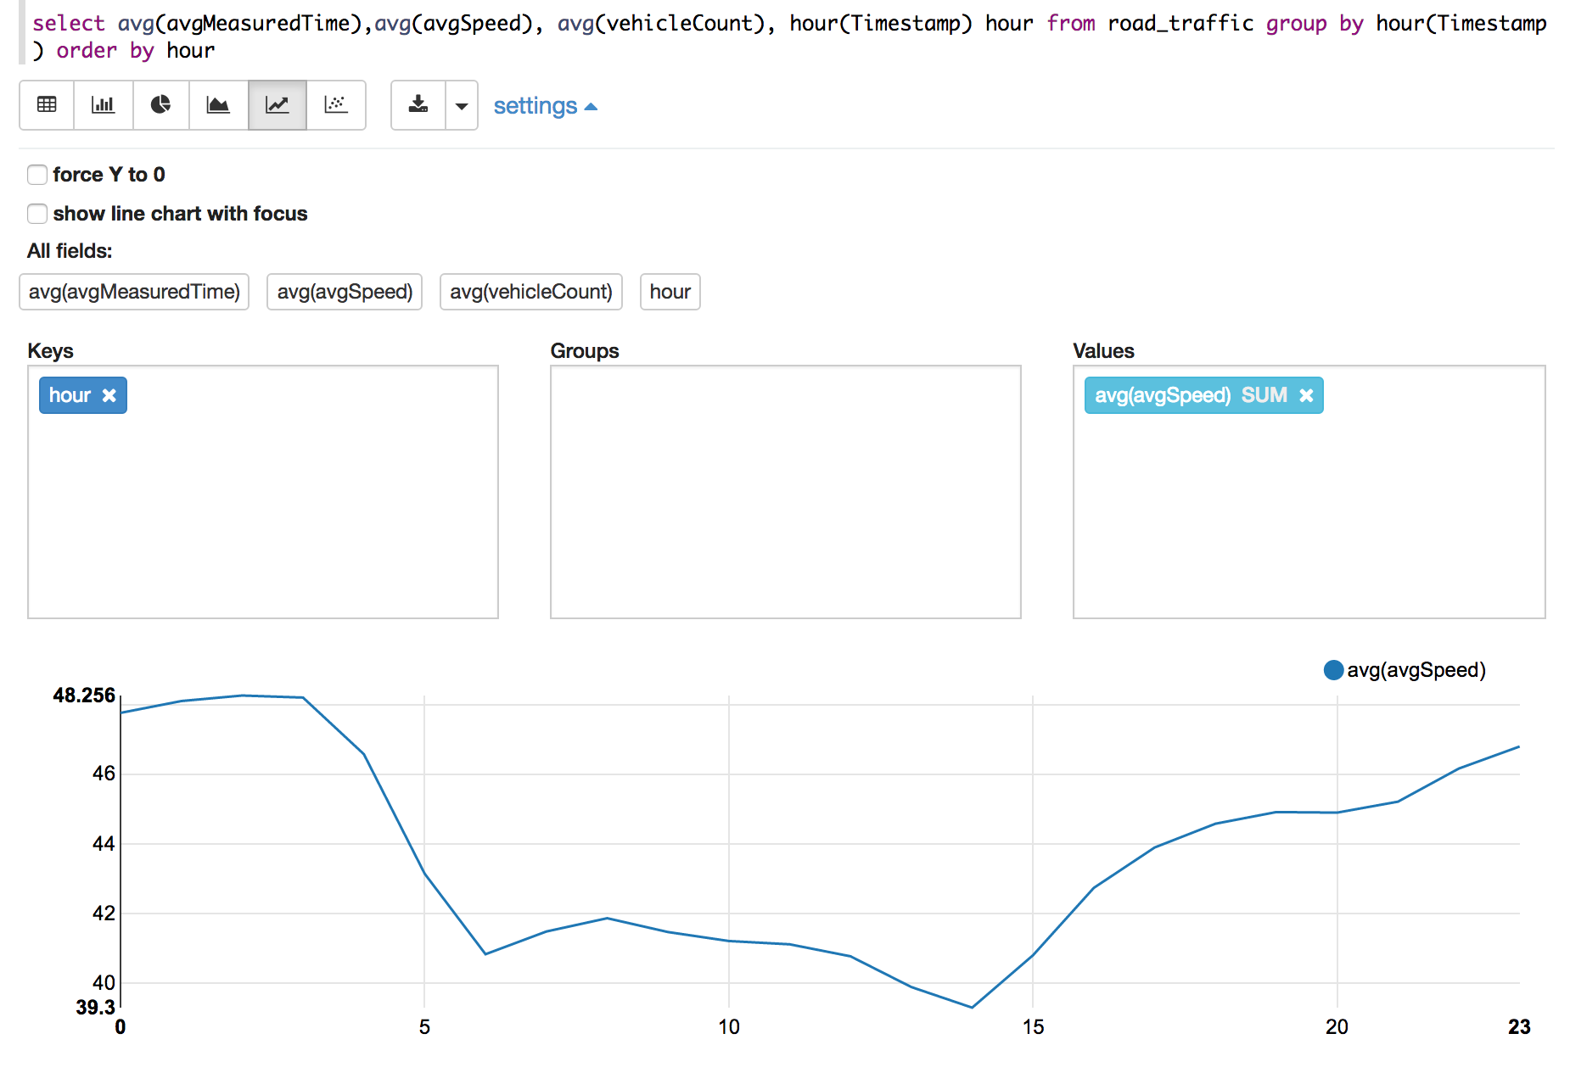
Data Visualization Average speed by hour of day

Slide 15
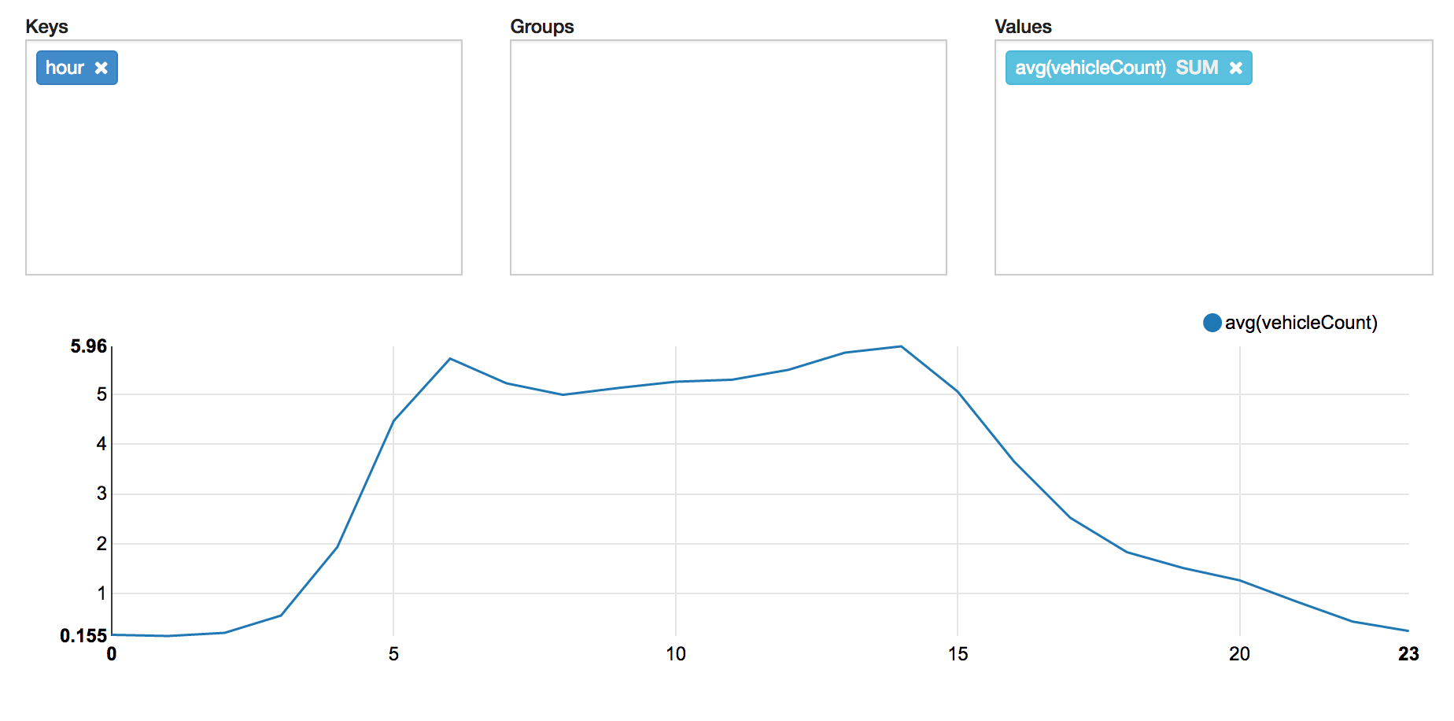
Data Visualization Average vehicle count by hour of day

Slide 16
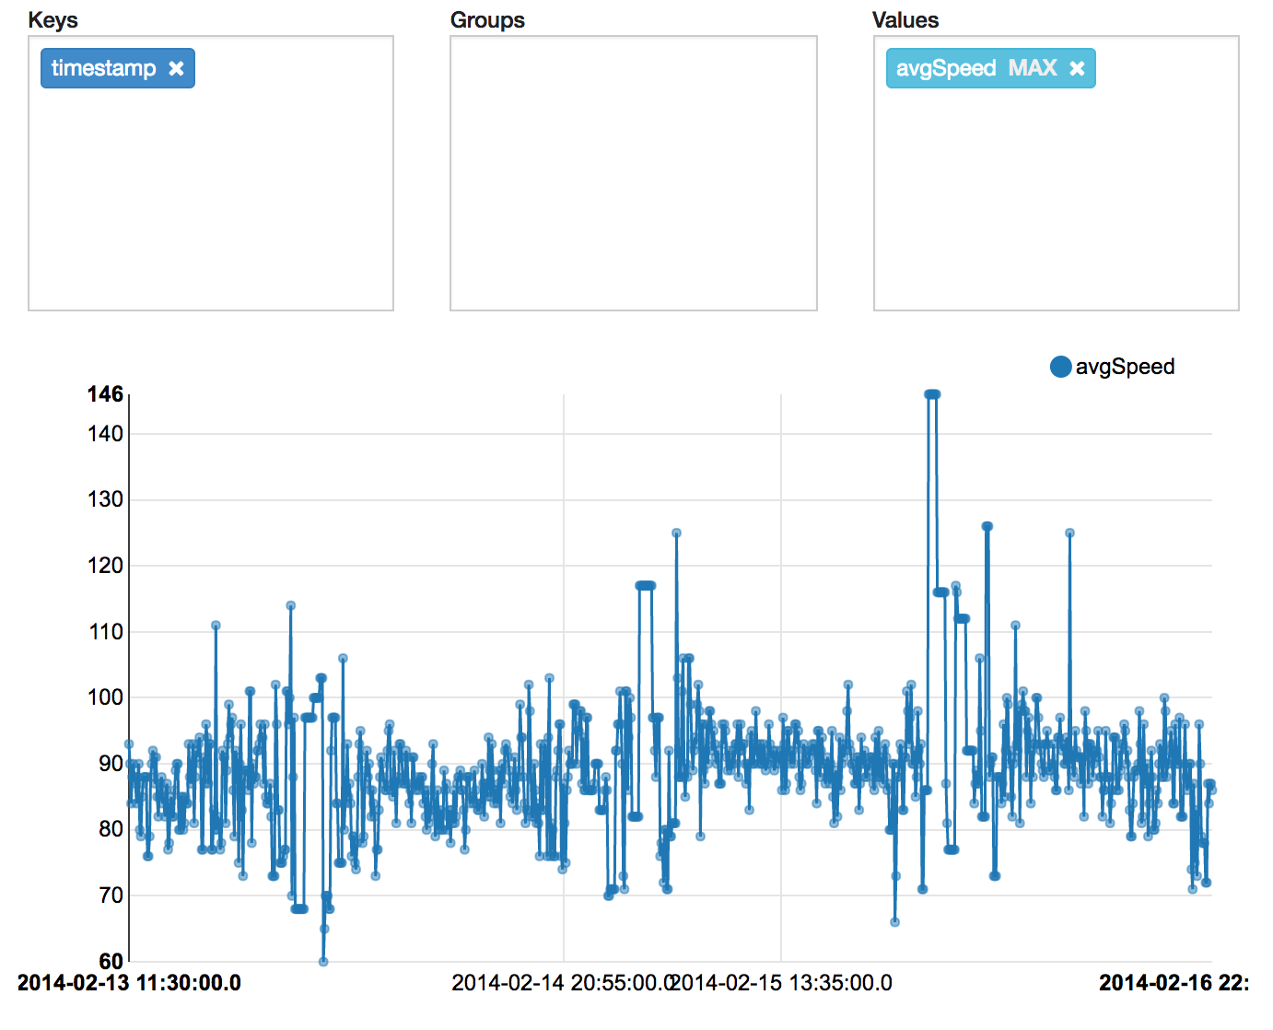
Data Visualization Time series of average speed

Slide 17
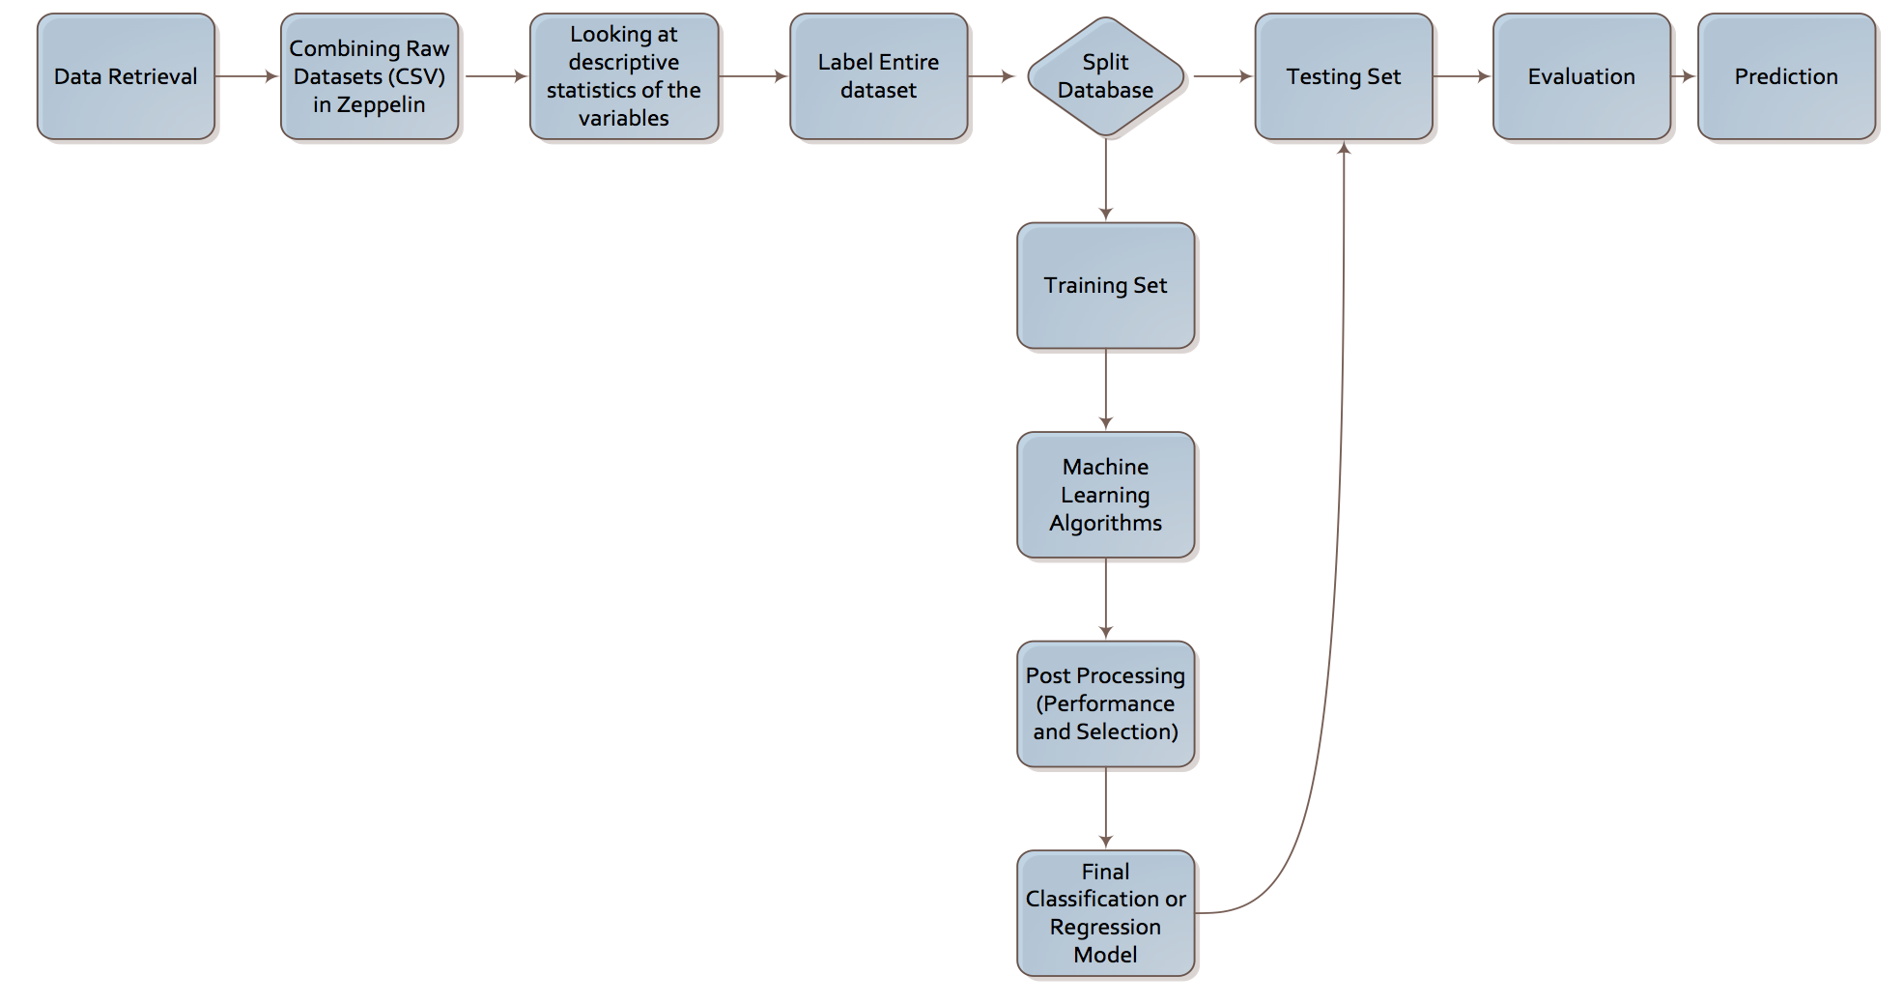
Method

Slide 18
Method
Let’s summarize the method with use of pseudo code as below:
Download all datasets available from the website http://iot.ee.surrey.ac.uk:8080/datasets.html
Using Spark, load and combine all the datasets
Using SQL and R, look at the descriptive statistics of the dataset. Create a correlation matrix between different numerical variables and create histograms, scatter plots and line graphs to better understand the data.
Label the dataset into different levels of congestion based on the average speed
Split the dataset into training and test data sets for cross validation and evaluation of the models to be created
Build different supervised learning models based on training datasets using different packages in R
Decision Trees
Support Vector Machines
Random Forests
Time Series Analysis (e.g., ARIMA)
Evaluate the models with different performance metrics to pick the best model that can be used for prediction
Select the final model

Slide 19
Method
Decision Trees
Decision tree is an algorithm used for building classification models whose output looks like a tree structure.
A decision tree is a flowchart-like structure in which each internal node represents a test on an attribute, each branch represents the outcome of the test and each leaf node represents a class label, which is the decision taken after computing all attributes.
Once the decision tree is build we start at the root node to apply the testing scenario and follow the branch that fits the scenario, ending up at one of the leaf nodes which are one of the classes of the classification model.
We can use Rpart package in R through zeppelin to perform decision trees algorithms.

Slide 20
Method
Support Vector Machines
Support Vector Machines (SVM) is another widely used algorithm for supervised learning as can be used for both classification and regression.
The basic idea of SVM is to map the data into a high-dimensional feature space via a nonlinear mapping
With a given training data set that are marked with labels, SVM training algorithm builds a model that assigns new data point into a specific category.
We can use e1071 package in R through zeppelin to build SVM model.

Slide 21
Method
Random Forest
Random forest does a collective classification using decisions from different decision tress.
A random forest consists of thousands of individual trees that are trained on different part of a training set.
Random forest provides very good accuracy compared to other classification algorithms and it can be very efficient for large data sets, which makes this algorithm very scalable.
We can use randomForest package in R through zeppelin to build a Random Forest model.

Slide 22
Method
Time Series Analysis
Since the dataset we are looking at is time based we can conduct time series analysis to predict future points in the series.
We can use the velocity data to predict future velocity or number of vehicles at a given time using time series models like Auto-Regressive Integrated Moving Average (ARIMA) model.
The auto correlation function (ACF) and partial auto correlation function (PACF) can be used to determine which order of auto regression and moving average is required for the model.

Slide 23
Method
Evaluation
There are many performance metrics that help us evaluate the performance of our models.
One popular method is to look at area under the ROC curve (AUC) to calculate the probability that a model will rank a randomly chosen positive instance higher than a randomly chosen negative instance.

